Slide 1
CIND 820
Initial Results and Code
Emily Chan
Notes:
Hi, my name is Emily Chan, and this is my video presentation for Module 3 of the CIND820 Capstone Project.
My project focuses on predicting medical appointment no-shows using machine learning classification techniques.
In this video, I’ll walk through my initial results, highlight key insights from the data, and explain the modeling process.

Slide 2
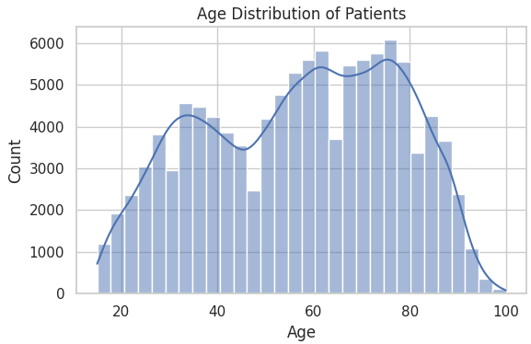
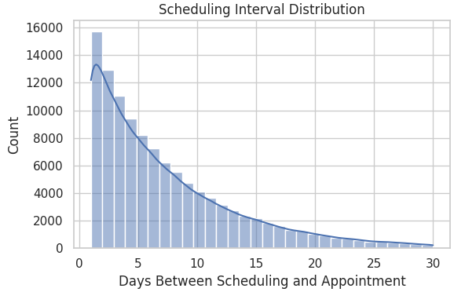
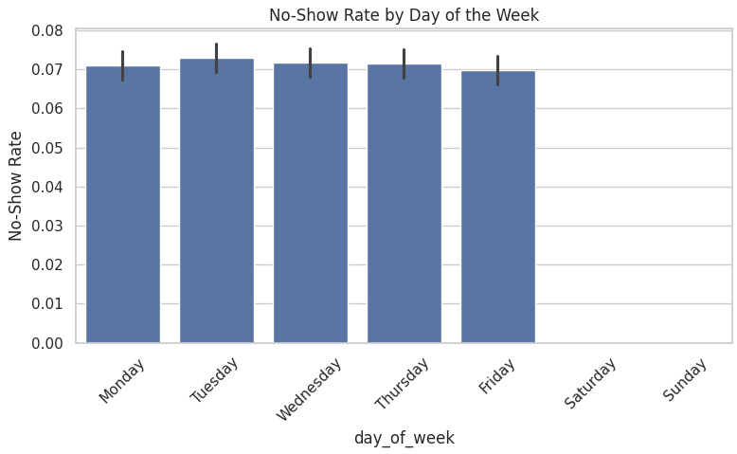
Data Analysis & Key Patterns
Notes:
The dataset includes three files: appointments.csv, patients.csv, and slots.csv.
After filtering out cancelled and unknown statuses, I focused on a binary classification problem: predicting whether a patient would attend or miss their appointment.
Key patterns emerged during exploratory data analysis:
Age distribution: Most patients are between 40 and 70 years old, with no pediatric data included.
Scheduling interval: Longer wait times between booking and appointment dates are associated with higher no-show rates.
Temporal features: Mondays and Fridays show slightly elevated no-show rates.
These insights guided my feature engineering and model selection.

Slide 3
Data Preparation
Raw Data Cleaning Feature Engineering Encoding Scaling Balanced Dataset(SMOTE) Ready for Modeling
Before Preprocessing | After Preprocessing
Raw CSV files | Cleaned DataFrames
Mixed data types | Standardized formats
Categorical variable | One-hot encoded features
Imbalanced classes | Balanced via SMOTE
Notes:
I performed several preprocessing steps:
Calculated scheduling intervals.
Extracted day of the week and hour of appointment.
Encoded categorical variables like sex and insurance type.
Addressed class imbalance using SMOTE, since 77% of appointments were attended and 23% were no-shows.
Scaled numerical features using StandardScaler.
The final dataset included demographic, temporal, and operational features, ready for modeling.

Slide 4
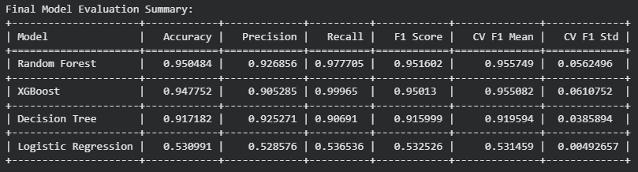
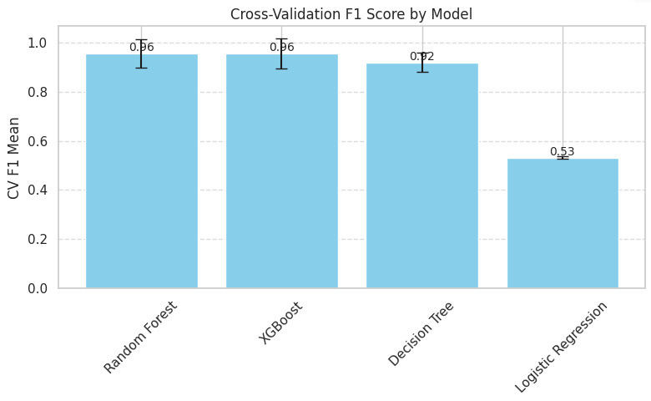
Model Development & Evaluation
Models trained:
Notes:
I trained four classification models:
Logistic Regression: Used as a baseline, but performed poorly with an F1 score of 0.53.
Decision Tree: Achieved an F1 score of 0.92, but showed sensitivity to data splits.
Random Forest: Delivered strong performance with an F1 score of 0.95.
XGBoost: Matched Random Forest in F1 score and achieved perfect recall, making it highly effective for identifying no-shows.
I also performed 5-fold cross-validation to ensure robustness. Random Forest and XGBoost showed consistent performance across folds, confirming their reliability.

Slide 5
Key Insights & Next Steps
Ensemble models outperform simpler ones
Temporal and scheduling features are strong predictors
Logistic Regression not suitable without transformation
Notes:
Based on the results:
Ensemble models are best suited for this task due to their ability to handle feature interactions and imbalanced data.
Scheduling interval and temporal features are strong predictors of no-show behavior.
Logistic Regression is not suitable without significant feature transformation.
For future improvements, I plan to:
Explore additional features, such as historical attendance.
Test the models on real-world datasets for external validation.

Slide 6
Code & Reproducibility
Code developed in Python using Google Colab
GitHub repo: https://github.com/emchan4/CIND820-medical-no-show-prediction
Includes modular functions, visualizations, and reproducibility practices
Notes:
The code was developed in Python using Google Colab and is available on GitHub at: github.com/emchan4/CIND820-medical-no-show-prediction
It includes:
A well-documented Jupyter Notebook.
Modular functions for data loading, preprocessing, and modeling.
Visualizations saved for reporting.
Random seeds and dependencies for reproducibility.

Slide 7
Thank you

